Slide 1

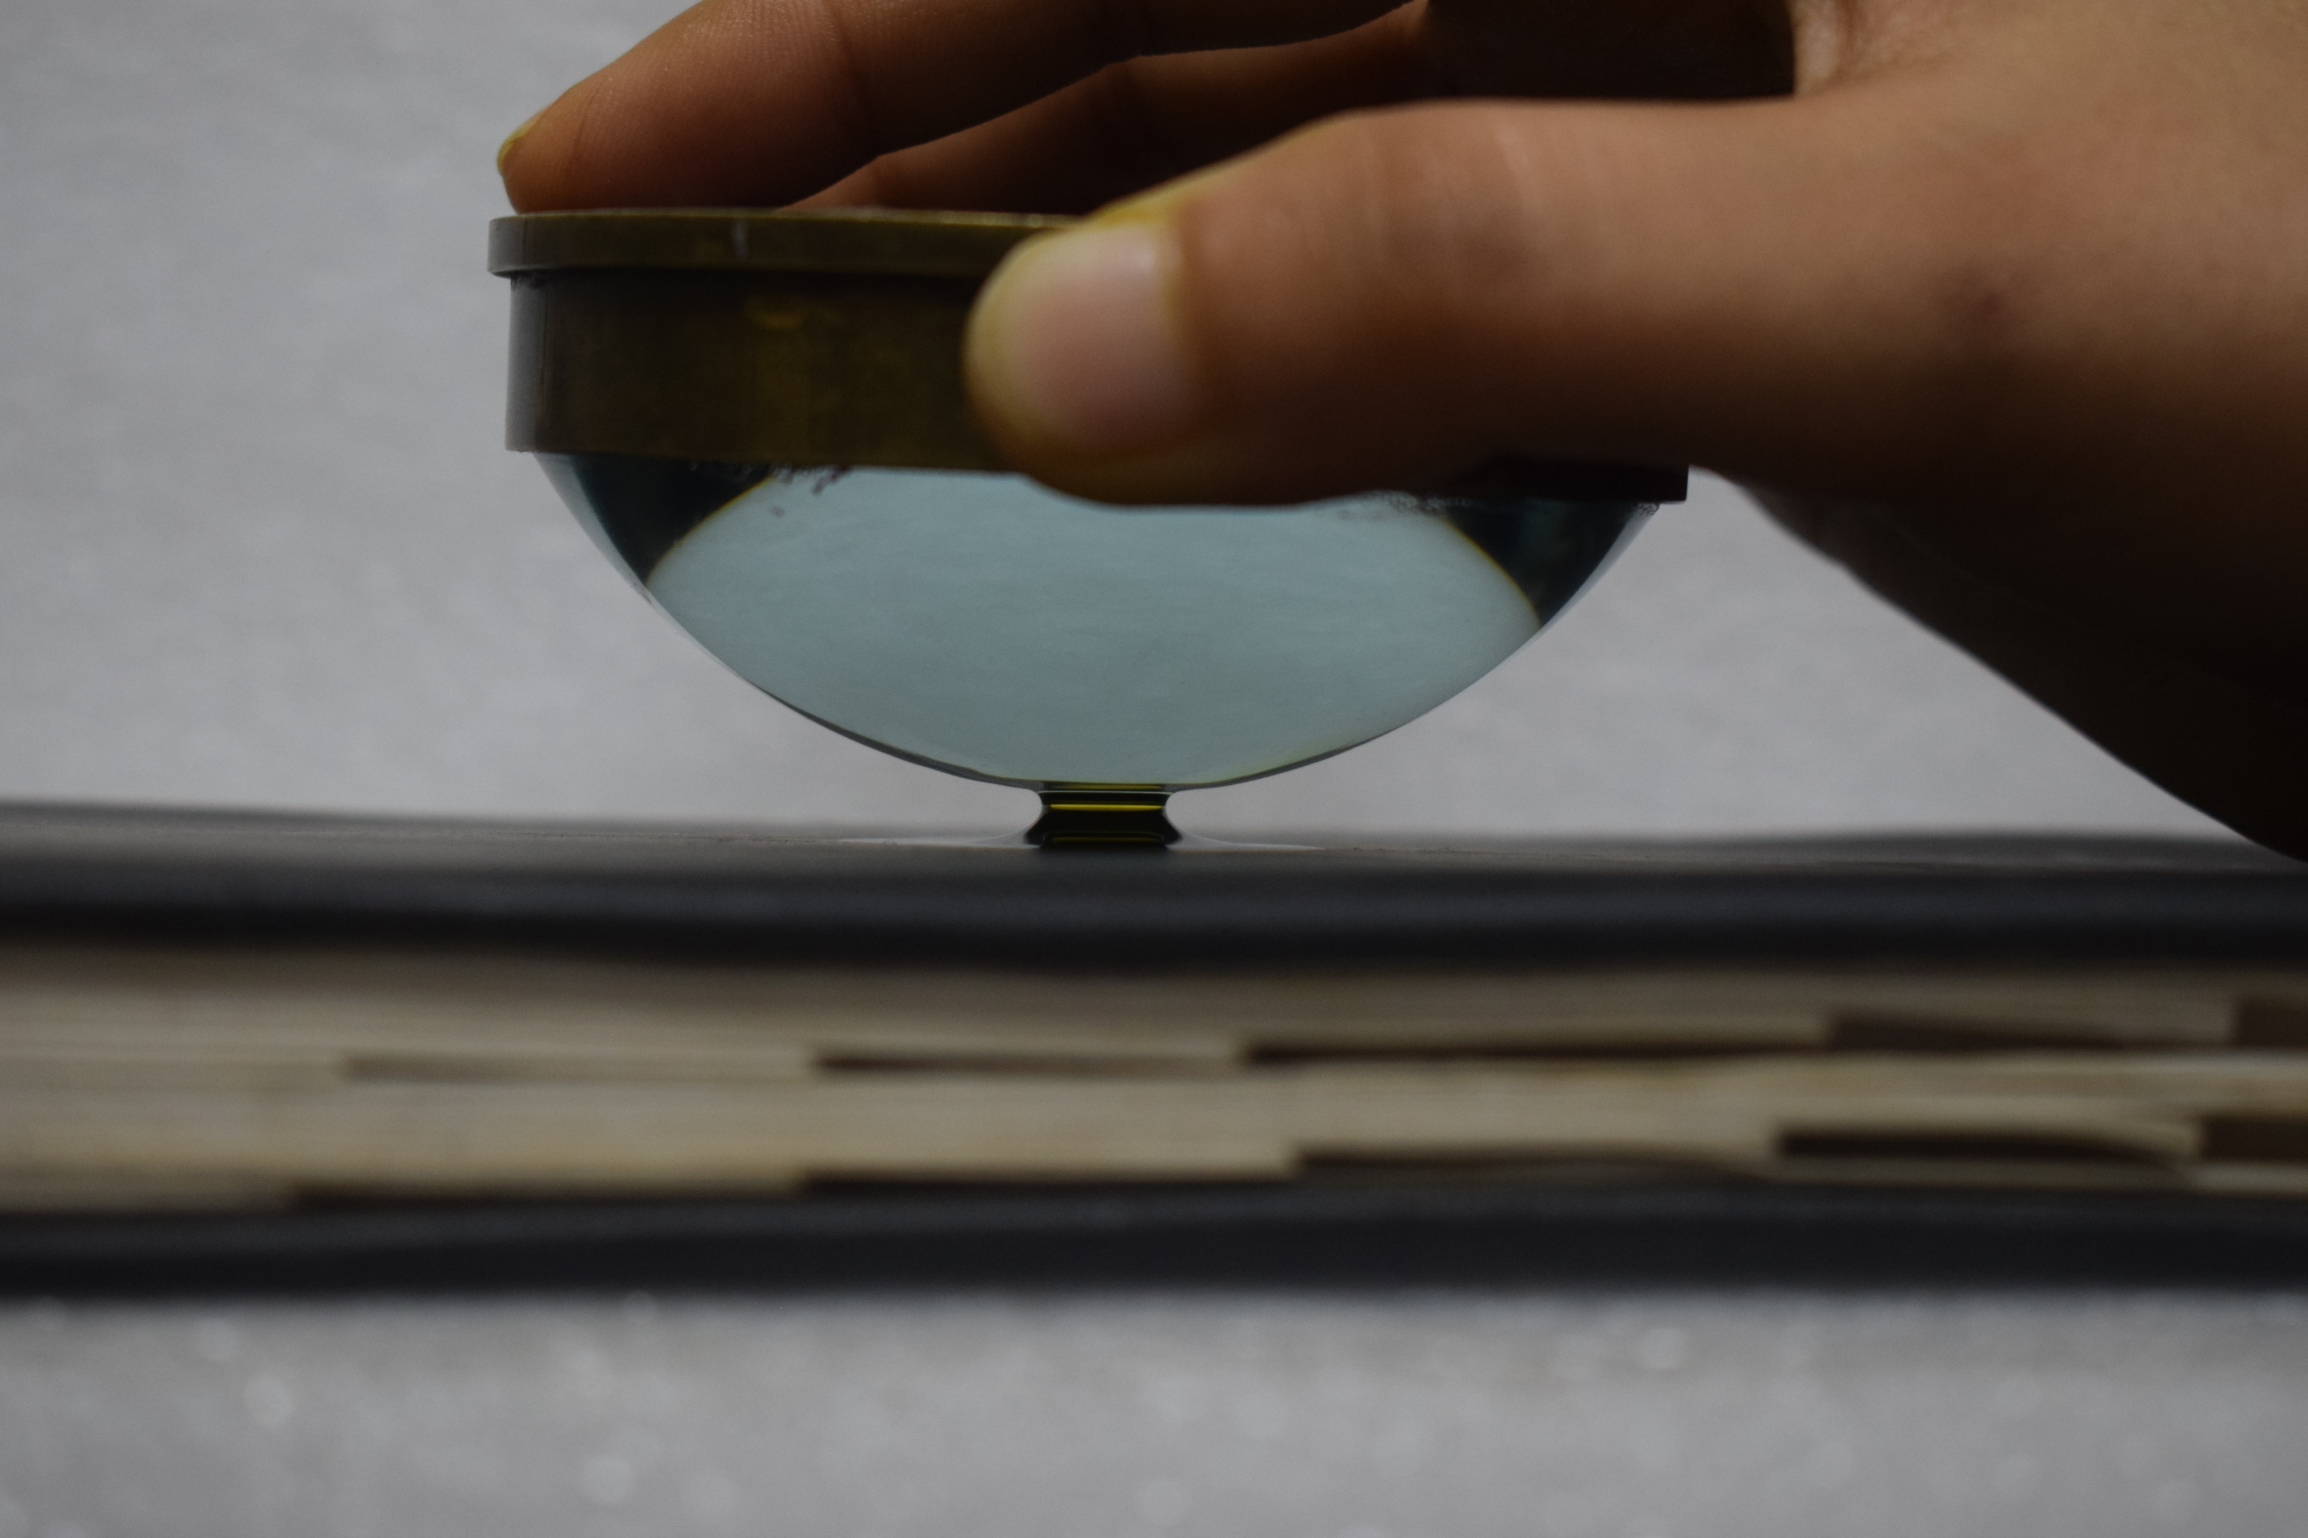
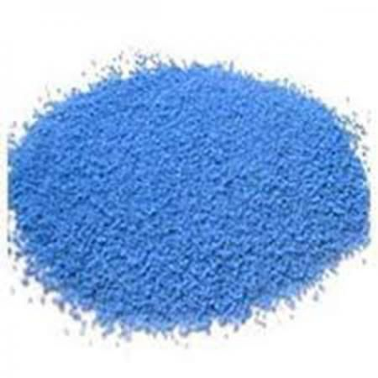
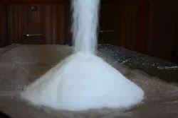
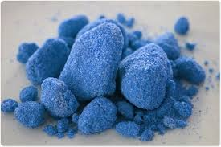


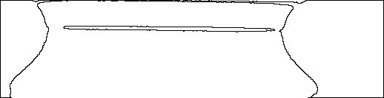

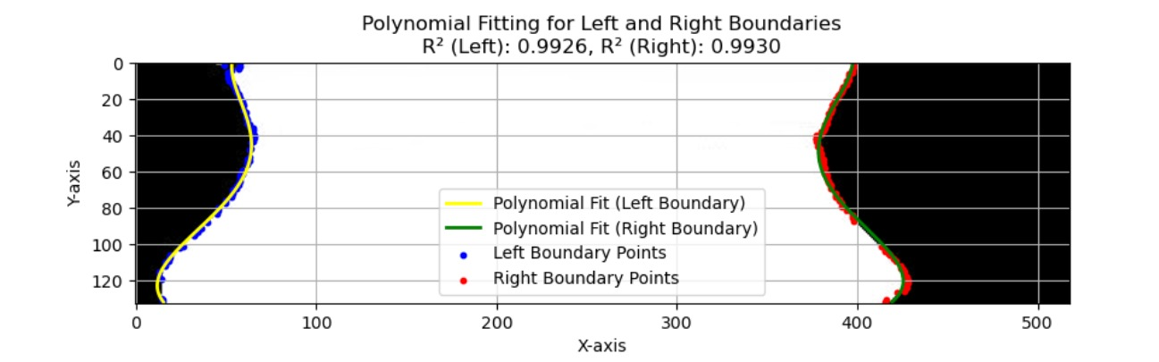
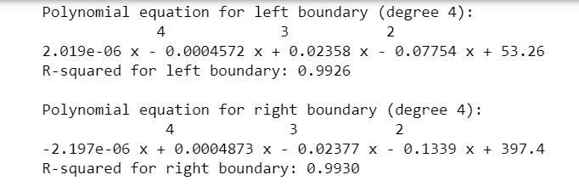
CLUMPING OF NON-SPHERICAL PARTICLES
Chiraag M Kathiresan, Sanat Kumar Jha, Meena S, Naman Mehta
Faculty Supervisor Name: Anshu Anand
UG TA Name: Geet Gopal Asati
Problem Statement
Experiment Details
Cake formation phenomenon in pharmaceutical, food industries is undesirable and unavoidable.
Because, clump formation interferes with packaging, transport, flowability, and consumption.
Cohesion between the particles causes this clumping by the formation of liquid bridge.
Our objective is to study the shape of this liquid bridge.
Here, we have taken the base case of pendular shaped liquid bridge.
The pendular shaped liquid bridge is formed between the two particles.
The magnified image of this liquid bridge is captured using a high-resolution camera.
Using imageJ software, the binary outline of the image is extracted.
Methodology
Results & Discussion
Image processing (binary conversion, thresholding, and edge detection) is done to extract boundaries from an image using an imageJ software.
Boundary detection finds left and right edges of objects within the image.
The boundary data points in coordinate form is stored in Data Frames and saved to CSV files.
Extract contours and classify boundary points.
Perform Piecewise Linear Curve fitting.
Generate fitted y values for plotting.
Calculate R² values to determine the accuracy of the fit and visualizes the data along with the fitted curves.
Display the Piecewise Linear Equations.
Result are plotted.
Polynomial fitting for left and right boundaries results in the following graph.
Using Python software, the equations of the boundaries are found.
Conclusion & Applications
Visual and quantitative analysis of the formation of the pendular liquid bridge between two particles were done successfully.
Equations of both left and right edges of the bridge were extracted with high accuracy.
Thus, we have experimentally validated the literature simulation.
By studying the shape of the liquid bridge, we can determine the liquid bridge force.
This would be helpful in studying the effects of clumping and in optmizing the industrial processes.
Reference
Anshu Anand, Jennifer S. Curtis, Carl R. Wassgren, Bruno C. Hancock, and William R. Ketterhagen. (2015) Experimental Study of Wet Cohesive Particles Discharging from a Rectangular Hopper. ACS Publications.
Course TMI -102 (Tinkering)
Presentation Group # & POSTER ID #

